Slide 1
CHAPTER 1 - Introduction
Database Systems -
Introduction to Databases and Data Warehouses

Slide 2
DBMS
DBMS contains information about a particular enterprise
Collection of interrelated data
Set of programs to access the data
An environment that is both convenient and efficient to use
Database Applications:
Banking: transactions
Airlines: reservations, schedules
Universities: registration, grades
Sales: customers, products, purchases
Online retailers: order tracking, customized recommendations
Manufacturing: production, inventory, orders, supply chain
Human resources: employee records, salaries, tax deductions
Databases can be very large.
Databases touch all aspects of our lives

Slide 3
Drawbacks of using file systems to store data
Data redundancy and inconsistency
Multiple file formats, duplication of information in different files
Difficulty in accessing data
Need to write a new program to carry out each new task
Data isolation — multiple files and formats
Integrity problems
Integrity constraints (e.g., account balance > 0) become “buried” in program code rather than being stated explicitly
Hard to add new constraints or change existing ones
Notes:
3

Slide 4
Drawbacks of using file systems to store data (Cont.)
Atomicity of updates
Failures may leave database in an inconsistent state with partial updates carried out
Example: Transfer of funds from one account to another should either complete or not happen at all
Concurrent access by multiple users
Concurrent access needed for performance
Uncontrolled concurrent accesses can lead to inconsistencies
Example: Two people reading a balance (say 100) and updating it by withdrawing money (say 50 each) at the same time
Security problems
Hard to provide user access to some, but not all, data
Database systems offer solutions to all the above problems

Slide 5
INITIAL TERMINOLOGY
Data - facts that are recorded and can be accessed
Data formats – text, numbers, figures, graphics, images, audio/video recordings and more
Data is recorded and kept because it is considered to be of use to an intended user
Information - refers to the data that is accessed by a user for some particular purpose
Typically, getting the needed information from a collection of data requires performing an activity, such as searching through, processing, or manipulating the data in some form or fashion
Notes:
The terms “data” and “information” are illustrated on Page 1 by the following examples:
Phone book lookup of the phone number for Pizza Adria
ZAGI Retail Company manager needing information about quarterly apparel sales
The terms “data” and “information” are often interchanged and used as synonyms for each other (information is simply the data that we need)

Slide 6
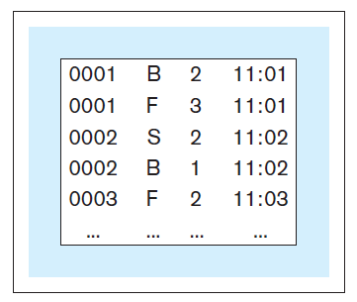
INITIAL TERMINOLOGY
Metadata - data that describes the structure and the properties of the data
Metadata is essential for the proper understanding and use of the data
Data without metadata - example

Slide 7
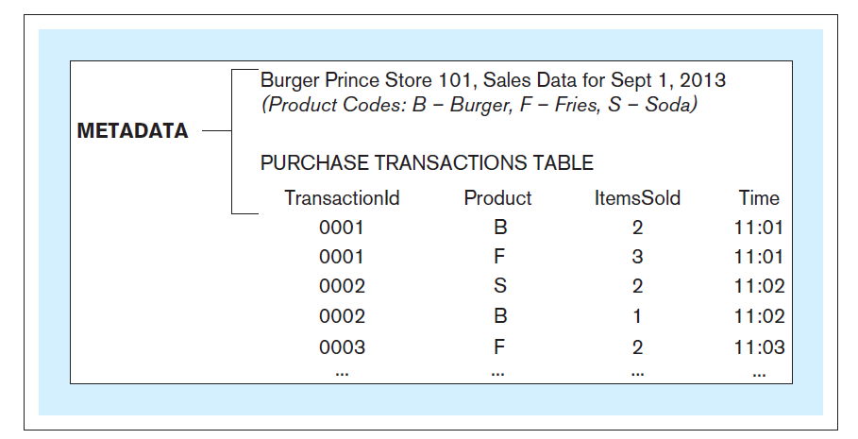
INITIAL TERMINOLOGY
Data with metadata - example

Slide 8
INITIAL TERMINOLOGY
Database - structured collection of related data stored on a computer medium. Organizes the data in a way that facilitates efficient access to it
Database metadata – represents the structure of the database
Database content that is not the data itself (data about the data)
Contains:
Names of data structures
Data types, Data descriptions, Data Relationships
Data constraints
Other information describing the characteristics of the data
Chapter 1 – Slide 8

Slide 9
DB Models
Relational model (RDBMS)
Entity-Relationship data model (ER)
mainly for database design
Object-based data models
Object-oriented and Object-relational
Semistructured data model
XML
Other older models:
Network model
Hierarchical model
Big Data!!!

Slide 10
INITIAL TERMINOLOGY
Database management system (DBMS) - software used for:
Creation of databases
Insertion, storage, retrieval, update, and deletion of the data in the database
Maintenance of databases
Database system - computer-based system whose purpose is to enable an efficient interaction between the users and the information captured in a database
Chapter 1 – Slide 10
Notes:
A comparison of the relationship between a DBMS and a database with the relationship between the presentation software (such as MS PowerPoint) and a presentation, is given on Pages 2-3.

Slide 11
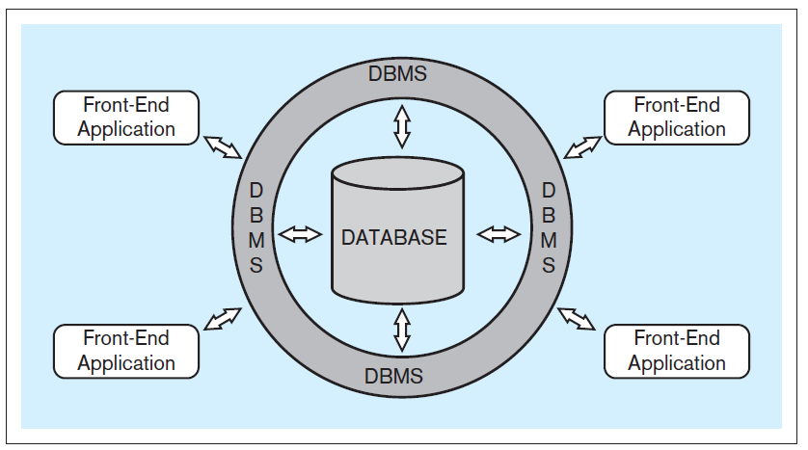
INITIAL TERMINOLOGY
Typical database system architecture

Slide 12
INITIAL TERMINOLOGY
Front-end applications - provide a mechanism for easy interaction between the users and the DBMS
End-users (business-users) - users using a database system to support their tasks and processes
Indirect interaction - end-user communicating with the database through front-end applications
Direct interaction - end-user communicating with the database directly through DBMS
Notes:
An example of an ATM user interacting with the DBMS by using a front-end application is described on Page 3.

Slide 13
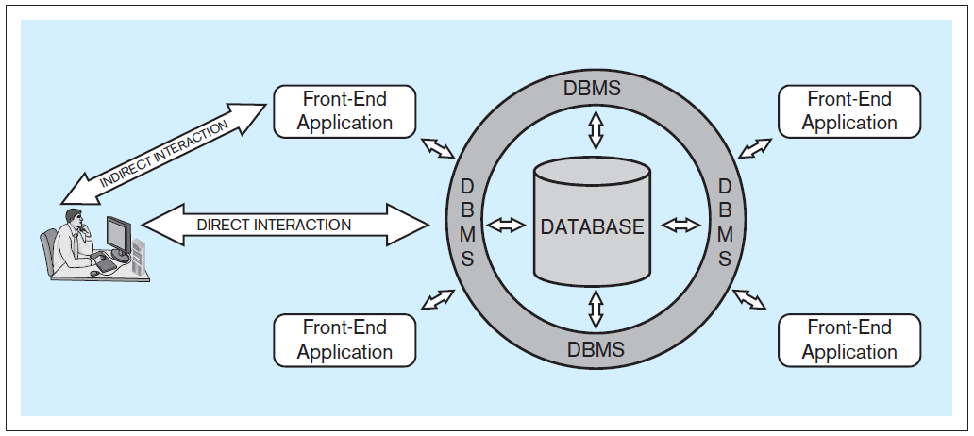
INITIAL TERMINOLOGY
Typical database system architecture
Notes:
The discussion of indirect and direct interaction is given on Pages 3-4.

Slide 14
Levels of Abstraction
Physical level: describes how a record (e.g., customer) is stored.
Logical level: describes data stored in database, and the relationships among the data.
type instructor = record
ID : string; name : string; dept_name : string; salary : integer;
end;
View level: application programs hide details of data types. Views can also hide information (such as an employee’s salary) for security purposes.
Notes:
14

Slide 15
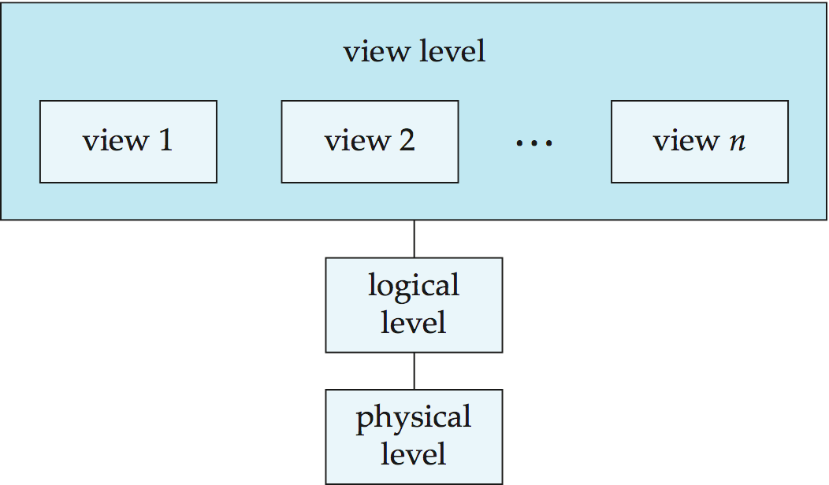
View of Data
An architecture for a database system
Physical Data Independence
Notes:
15

Slide 16
Instances and Schemas
Similar to types and variables in programming languages
Schema – the logical structure of the database
Example: The database consists of information about a set of customers and accounts and the relationship between them
Analogous to type information of a variable in a program
Instance – the actual content of the database at a particular point in time
Analogous to the value of a variable
Physical Data Independence – the ability to modify the physical schema without changing the logical schema
Applications depend on the logical schema
In general, the interfaces between the various levels and components should be well defined so that changes in some parts do not seriously influence others.
Notes:
16

Slide 17
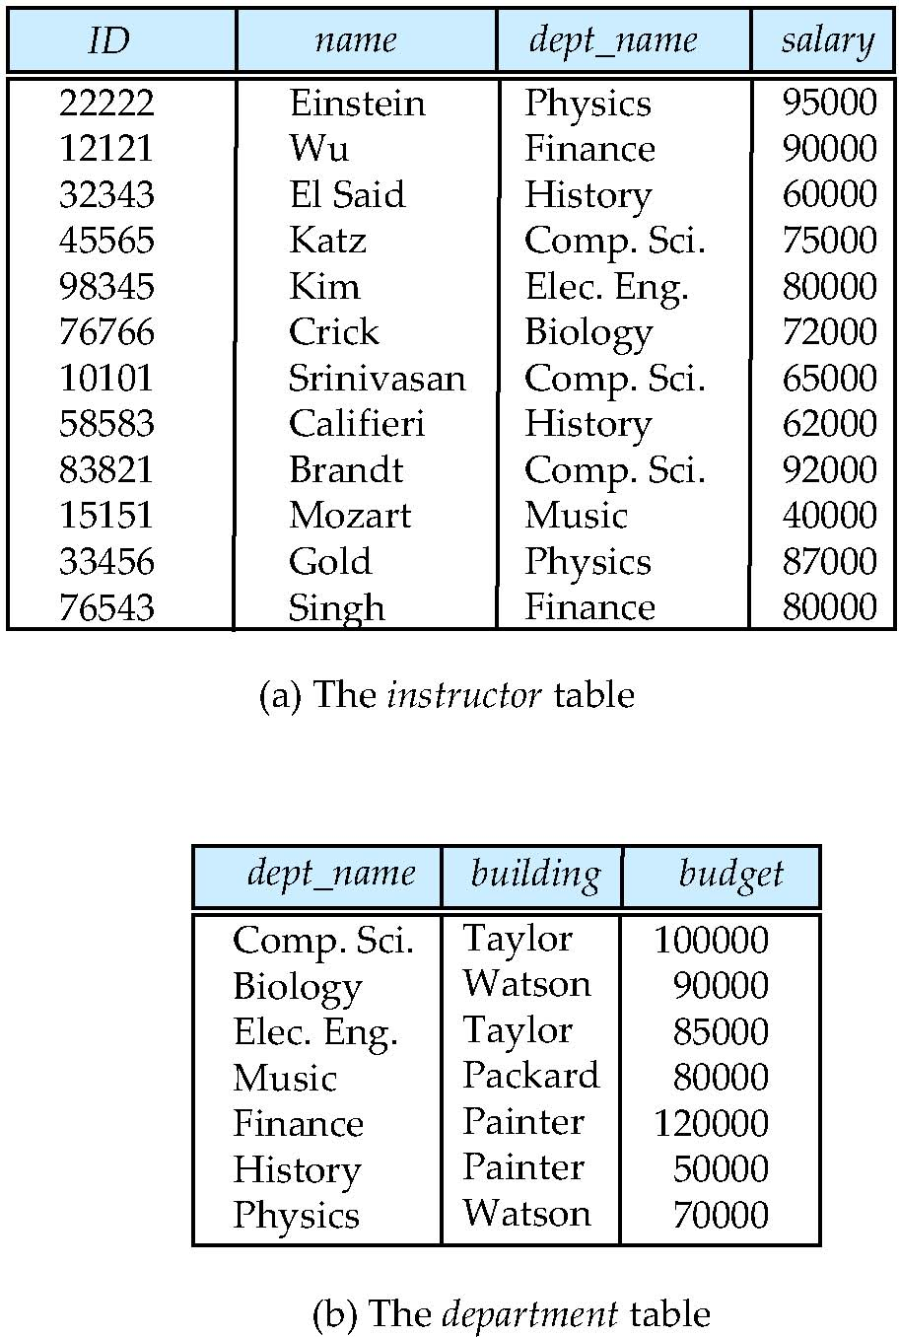
Relational Model
Relational model (Chapter 2)
Example of tabular data in the relational model
Columns
Rows
Notes:
17

Slide 18
A Sample Relational Database
Notes:
18

Slide 19
Data Manipulation Language (DML)
Language for accessing and manipulating the data organized by the appropriate data model
DML also known as query language
SQL is the most widely used query language
Example:
SELECT id, name, gpa
FROM students
WHERE gpa>3.0;
Notes:
19

Slide 20
SQL Samples – first look
SQL: widely used non-procedural language
Example: Find the name of the instructor with ID 22222 select name from instructor where instructor.ID = ‘22222’
Example: Find the ID and building of instructors in the Physics dept.
select instructor.ID, department.building from instructor, department where instructor.dept_name = department.dept_name and department.dept_name = ‘Physics’
Application programs generally access databases through one of
Language extensions to allow embedded SQL
Application program interface (e.g., ODBC/JDBC) which allow SQL queries to be sent to a database
Notes:
20

Slide 21
DDL Specification
Specification notation for defining the database schema
Example:
create table instructor ( ID char(5), name varchar(20), dept_name varchar(20), salary numeric(8,2))
DDL compiler generates a set of table templates stored in a data dictionary
Data dictionary contains metadata (i.e., data about data)
Database schema
Integrity constraints
Primary key (ID uniquely identifies instructors)
Referential integrity (references constraint in SQL)
e.g. dept_name value in any instructor tuple must appear in department relation
Authorization
Notes:
21

Slide 22
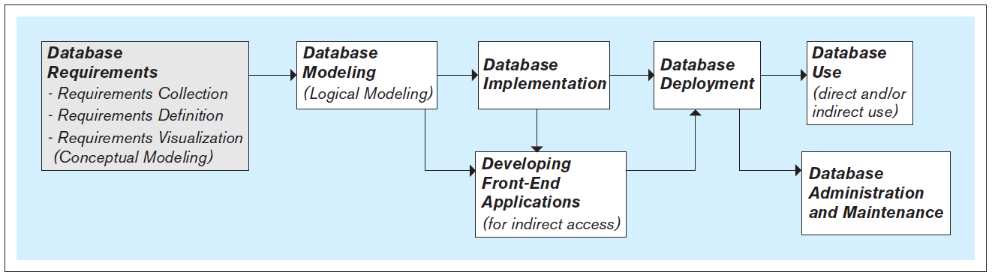
STEPS IN THE DEVELOPMENT OF DATABASE SYSTEMS

Slide 23
STEPS IN THE DEVELOPMENT OF DATABASE SYSTEMS
Requirements collection, definition, and visualization - results in the requirements specifying which data the future database system will hold and in what fashion, and what the capabilities and functionalities of the database system will be
The collected requirements should be clearly defined and stated in a written document, and then visualized.
Conceptual database model – a visualization of requirements by using a conceptual data modeling technique (such as entity-relationship [ER] modeling)
Notes:
The first and most critical step in the development of the database.

Slide 24
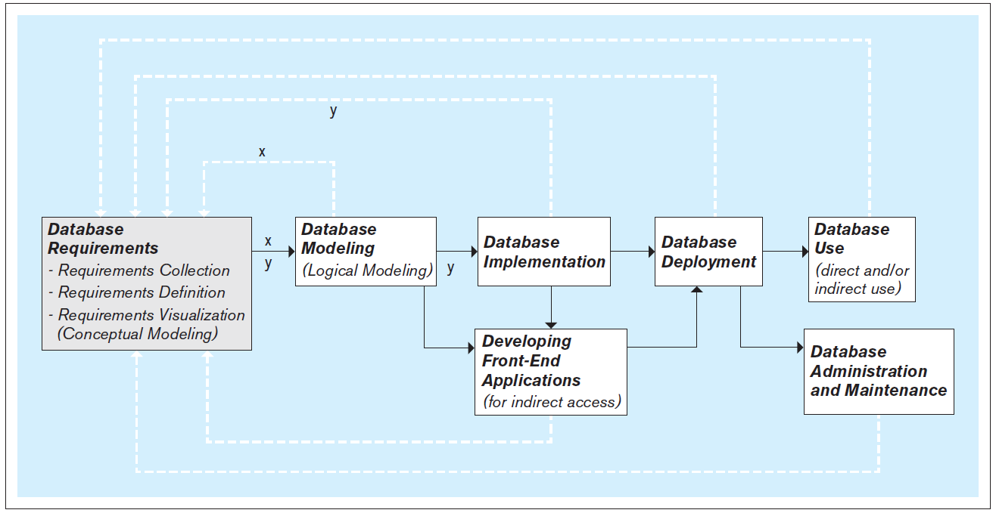
STEPS IN THE DEVELOPMENT OF DATABASE SYSTEMS
Iterative nature of the database requirements collection, definition, and visualization process
Notes:
The discussion about iterative nature of the database requirements collection, definition, and visualization process is given on Pages 5-6.

Slide 25
STEPS IN THE DEVELOPMENT OF DATABASE SYSTEMS
Database modeling (logical database modeling ) - creation of the database model that is implementable by the DBMS software
Logical database modeling follows conceptual database modeling
Database implementation - using a DBMS to implement the database model as an actual database
Most modern databases are implemented using a relational DBMS (RDBMS) software
Notes:
A database has two models:
Conceptual model - created as a visualization of requirements during the requirements collection, definition, and visualization step and serves as a as a blueprint for the actual (logical) database model
Logical model - actual database model, created during the database modeling step to be used in the subsequent step of database implementation using the DBMS

Slide 26
STEPS IN THE DEVELOPMENT OF DATABASE SYSTEMS
Developing front-end applications - designing and creating applications for indirect use by the end-users
Front-end applications are based on the database model and the requirements specifying the front-end functionalities
Front-end applications contain interfaces (such as forms and reports) accessible via a navigation mechanism (such as a menu)
Database deployment - releasing the database system for use by the end users
Notes:
The design and creation of front-end applications can commence and proceed in parallel with database implementation (as shown in Figure 5.1). The actual creation of a front-end application involves connecting it to the database. Connecting front-end application to the database can only be done once the database is implemented.

Slide 27
STEPS IN THE DEVELOPMENT OF DATABASE SYSTEMS
Database use - the insertion, modification, deletion and retrieval of the data in the database system
Database administration and maintenance - performing activities that support the database end user, including dealing with technical issues, such as:
Providing security for the information contained in the database
Ensuring sufficient hard-drive space for the database content
Implementing the backup and recovery procedures
Notes:
The database system can be used indirectly, via the front-end applications, or directly via the DBMS.
SQL includes commands for insertion, modification, deletion and retrieval of the data. These commands can be issued by front-end applications (indirect use), or directly by the end-users themselves (direct use)

Slide 28
PEOPLE INVOLVED WITH DATABASE SYSTEMS
Database analysts - involved in the requirements collection, definition, and visualization stage
Database designers (a.k.a. database modelers or architects) - involved in the database modeling stage
Database developers – in charge of implementing the database model as a functioning database using the DBMS software
Front-end applications analysts and developers
Front-end application analysts - in charge of collecting and defining requirements Front-end applications developers - in charge of creating
Database administrators (DBAs) - perform the tasks related to the maintenance and administration of a database system
Database end users - use a database system to support their work
Notes:
It is not uncommon for the same people to perform more than one of these roles. In fact (especially in smaller companies and organizations), the same people may be in charge of all aspects of the database system, including the design, implementation, administration, and maintenance.

Slide 29
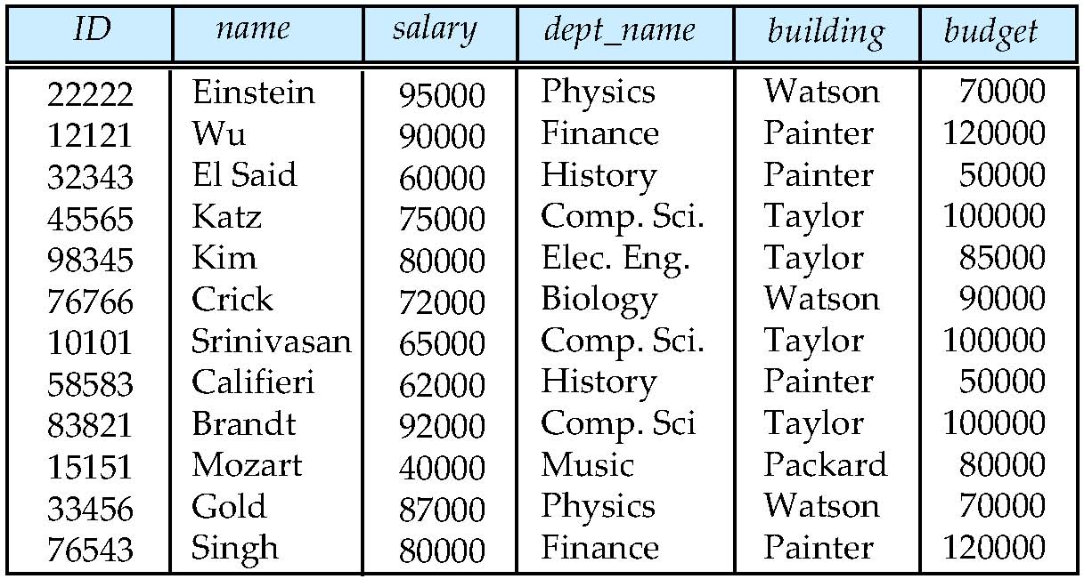
Database Design?
Is there any problem with this design?
What happen if we change the value of the Physics Department budget
Notes:
29

Slide 30
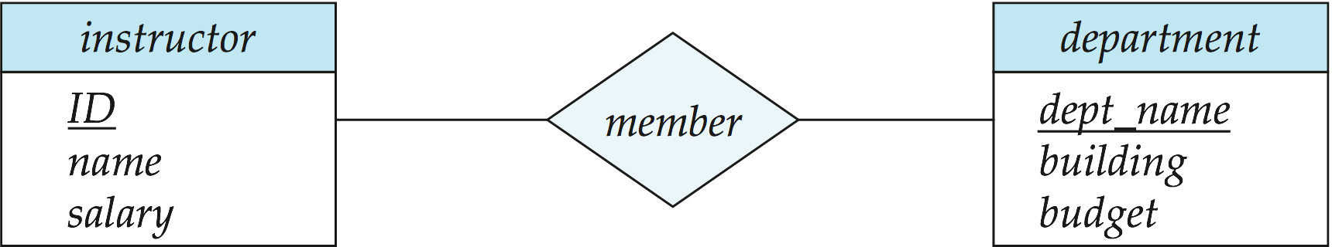
Design Approaches
Normalization Theory (Chapter 8)
Formalize what designs are bad, and test for them
Entity Relationship Model (Chapter 7)
Models an enterprise as a collection of entities and relationships
Entity: a “thing” or “object” in the enterprise that is distinguishable from other objects
Described by a set of attributes
Relationship: an association among several entities
Represented diagrammatically by an entity-relationship diagram:
Notes:
30

Slide 31
Object-Relational Data Models
Relational model: flat, “atomic” values
Object Relational Data Models
Extend the relational data model by including object orientation and constructs to deal with added data types.
Allow attributes of tuples to have complex types, including non-atomic values such as nested relations.
Preserve relational foundations, in particular the declarative access to data, while extending modeling power.
Provide upward compatibility with existing relational languages.
Notes:
31

Slide 32
XML: Extensible Markup Language
Defined by the WWW Consortium (W3C)
Originally intended as a document markup language not a database language
The ability to specify new tags, and to create nested tag structures made XML a great way to exchange data, not just documents
XML has become the basis for all new generation data interchange formats.
A wide variety of tools is available for parsing, browsing and querying XML documents/data
Notes:
32

